Slide 1
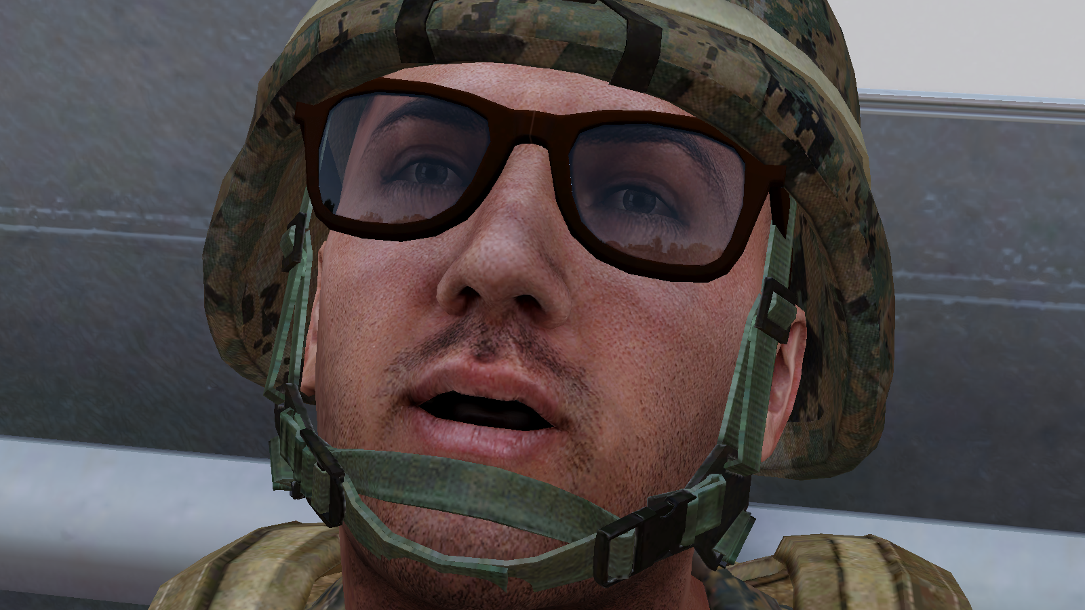
The Basics
How to Prevent Holes, Fix Holes and Make Holes, effectively
Rules
Communication
Working in a Group
Leading a Group

Slide 2
RULES
Mission Types
Respawns
Limited Respawns
One Life
Chat
Don’t talk if you’re dead.
Side chat for technical questions. (Steam chat for further help)
Do you need to ask a person?
Cancer
Gear

Slide 3
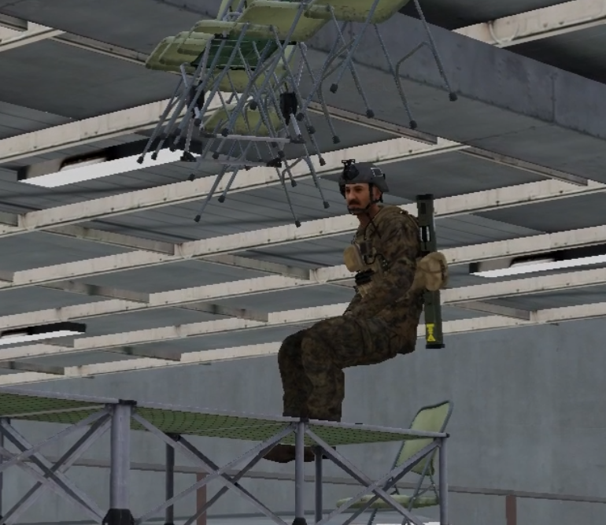
What is Cancer?
“A term used for something that is so fucked up, that it is figurably able of giving you cancer.”
“Johnny is so cancer that almost everyone hates him.” - Urban Dictionary
Cancer in moderation is ok.

Slide 4
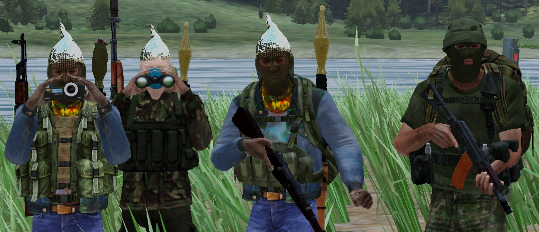
Gear
Pick sensible and suitable loadouts.
Don’t steal enemy weapons/gear/vehicles unless necessary.

Slide 5
COMMUNICATION
Radio Comms
Easy to know who messages are from and who they are intended for
Only relevant or useful information.
Keep messages short.
Radio checks should declare what channel is in question.
How to use multiple radios.
Reports
Type
Quantity
Direction/Azimuth
Range
Map Markers
Laser Designators

Slide 6
Working in a Group
Listen the first time.
Follow your squad/team leader.
Move as a unit, stick together.
Be aware of spacing.
ID your targets.
Make yourself useful.
Grenades/Explosives/Launchers.

Slide 7
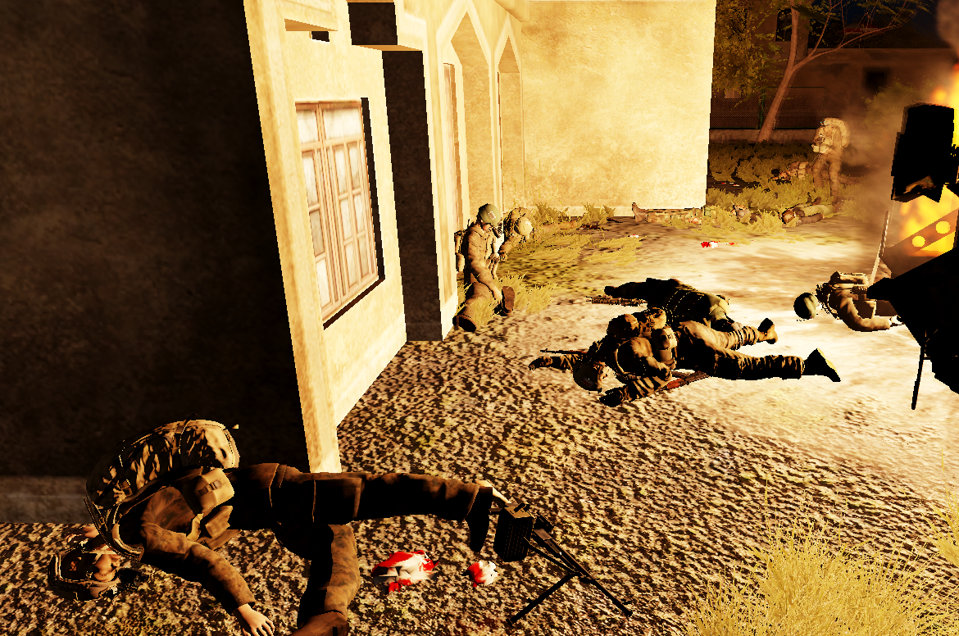
Grenades/Explosives/Launchers.
Call out before throwing/detonating/firing.
Leave enough time.
Grenades
Shift + G.
Explosives
One person should be in-charge.
Make sure people are clear.
Launchers
Clear back-blast thoroughly if possible.

Slide 8
Leading a Group
Leading
Be specific, call people by names.
You’re responsible for making sure people aren’t lost.
Responsible for managing the mounting/dismounting of vehicles.
Planning
Keep plans simple.
Keep plans flexible.

Slide 9
Questions and Answers

